Slide 1





NEXT GEN EMPLOYABILITY PROGRAM
Creating a future-ready workforce
Team member
College Name
Student Name : Saravanan D
Student ID : NM ID:au412321104051
SRI RAMANUJAR ENGINEERING COLLEGE

Slide 2

CAPSTONE PROJECT SHOWCASE
Next Gen Employability Program
Project Title
MUSIC WEB APPLICATION USING DJANGO FRAMEWORK
Abstract | Problem Statement | Project Overview | Proposed Solution | Technology Used | Modelling & Results | Conclusion

Slide 3
Next Gen Employability Program
Abstract
Music Streaming App is a powerful music streaming software that allows users to log into the
system, add albums, and add songs to the playlist. All songs listened to by other users registered on the system can also be found in the album.
This music software also has music download capabilities, allowing users to listen to music
even when they are not connected to the internet.
This project covers the following implementations:
An online product catalogue that can be browsed: The work starts with adding many new product catalogue features which includes displaying categories, products, and product details.
Searching the Catalogue: For the visual part, a text box is used in which the visitor can enter one or more words to search through the product catalogue. In Online Music Website, the words entered by the visitor are searched for in the songs' names and descriptions.
Handling Customer Accounts: In customer account system, details such as credit card numbers are stored in a database so that customers don't have to retype this information each time they place an order.
Source :

Slide 4
Next Gen Employability Program
Problem Statement
User Experience (UX):
What features and functionalities should be prioritized to enhance user satisfaction and retention
Performance and Scalability :
Design the application architecture to handle a large volume of concurrent users and scale dynamically based on demand
Cross-Platform Compatibility:
Develop the application to be responsive and compatible with various devices, including desktops, laptops, tablets, and smart phones
Social Integration:
What privacy and security measures should be implemented to protect user data and ensure a safe online environment
Monetization Strategy:
What monetization models (e.g., subscription, ad-based, premium content) are viable for sustaining the operation of the music application
:
Source :

Slide 5


Next Gen Employability Program
Project Overview
FEATURES:
Sign Up and Sign In option.
Google Sign Up and Sign In option.
Play song, view detailed information of song Search songs.
Filter songs based on language and singer. Create new playlist.
Add/Remove songs to/from playlist.
Add/Remove songs to/from favourites.
Scroll through recently played/viewed songs.
Explore songs through your personalized playlist and favourites.
Technology Stack:
Frontend: HTML5, CSS3, JavaScript (bootstrap 5)
Backend: Django, python
Database: SQLITE
Source :

Slide 6
Next Gen Employability Program
Proposed Solution
Personalized Music Discovery:
Music Harmony employs advanced recommendation algorithms that analyze user preferences, listening history, and social interactions to deliver personalized music recommendations tailored to each user's unique taste.
Users can explore a vast library of music tracks, albums, and artists curated specifically for them, ensuring they never run out of new music to discover
Seamless Streaming and Playback:
Enjoy high-quality audio streaming with adaptive bitrate technology that ensures smooth playback across various
devices and network conditions.
Music Harmony supports a wide range of audio formats and provides intuitive playback controls, allowing users to play, pause, skip, shuffle, and repeat tracks effortlessly.
Source :

Slide 7
Next Gen Employability Program
Interactive Social Features:
Connect with friends, fellow music enthusiasts, and favorite artists through Music Harmony's vibrant social community. Share your favorite tracks, albums, and playlists with friends, create collaborative playlists for group listening sessions, and engage in lively discussions about music trends and genres.
Customizable User Profiles:
Personalize your Music Harmony profile with your favorite genres, artists, and playlists, allowing the application to
tailor music recommendations and suggestions to your musical preferences.
Immersive Music Experience:
Dive deeper into the world of music with Music Harmony's immersive features, including artist biographies, album reviews, and curated playlists for every mood and occasion.
Stay updated with the latest music releases, exclusive interviews, and behind-the-scenes content from your
favorite artists and bands.
Source :

Slide 8
Next Gen Employability Program
Monetization Options:
Music Harmony offers flexible monetization models, including subscription plans, ad-supported free tiers, and premium content offerings such as exclusive live performances, concert streams, and merchandise.
Users can choose the monetization option that best suits their preferences and budget, ensuring a
sustainable revenue model for the platform while providing value to both free and paid user
Source :

Slide 9
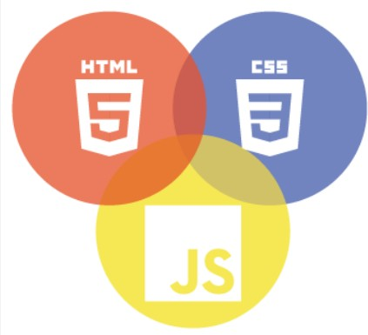

Next Gen Employability Program
Technology Used
Front-end
Back-end
Source :

Slide 10
Next Gen Employability Program
Modelling & Results
User Model:
Model: This includes representing user profiles, preferences, listening history, and interactions within the application.
Result: Personalized recommendations, customized playlists, and tailored content delivery based on individual user preferences and behavior. This enhances user engagement and satisfaction
Content Model:
Model: Represents music tracks, albums, artists, genres, and associated metadata.
Result: Efficient organization, search, and retrieval of music content. Enables features such as curated playlists, recommendations, and personalized music discovery experiences for users.
Performance Model:
Model: Monitoring and analyzing performance metrics such as server response times, page load times, streaming latency, and network bandwidth usage.
Result: Identification of bottlenecks, resource optimization, and improvement of system performance and scalability. Ensures a smooth and responsive user experience for all users.
Source :

Slide 11
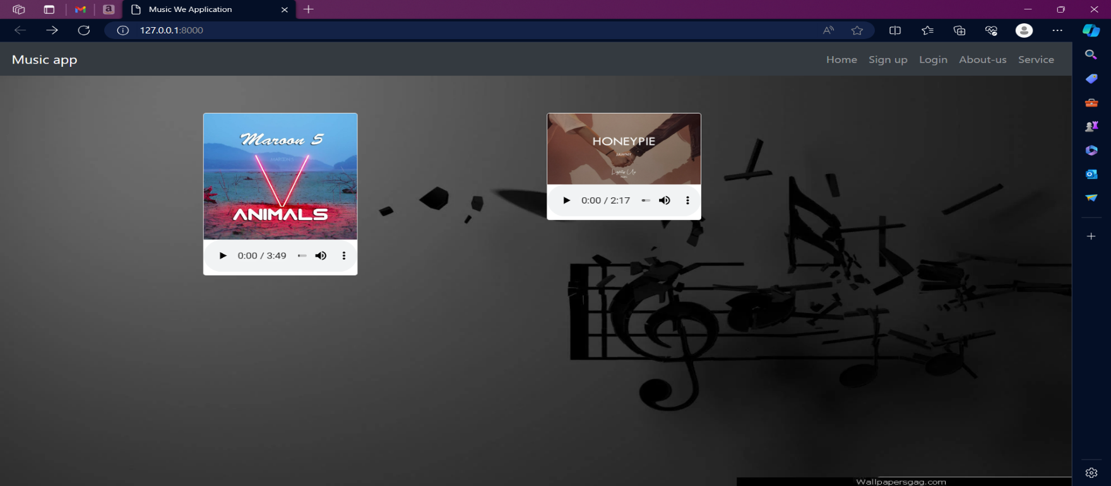
Homepage
Next Gen Employability Program

Slide 12
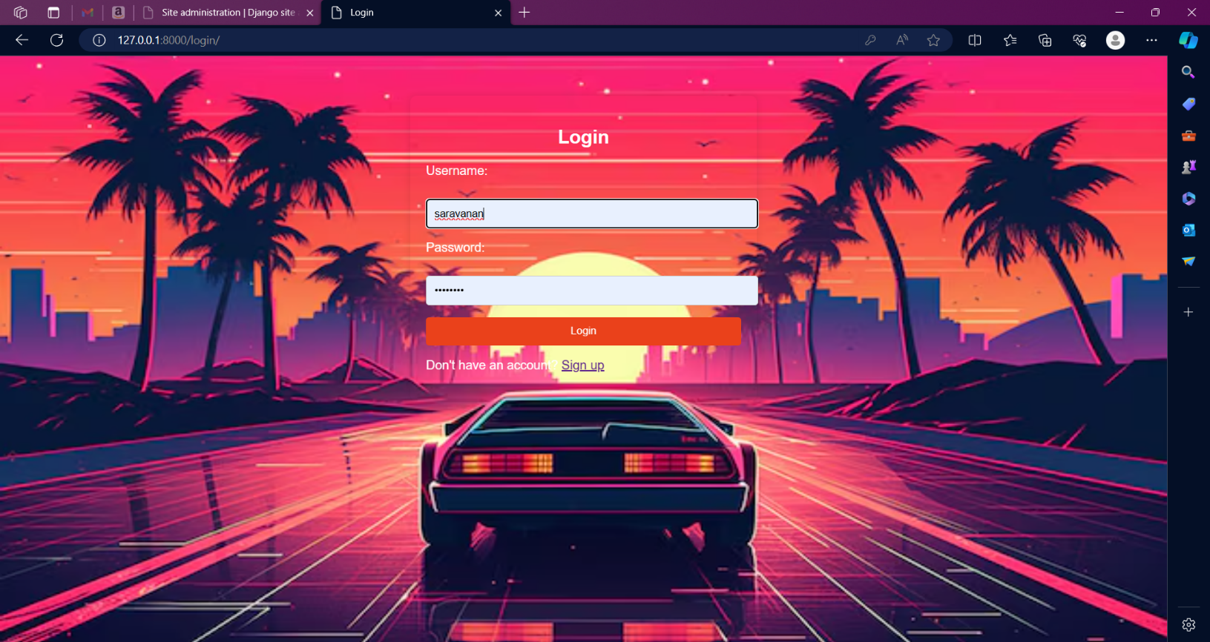
Next Gen Employability Program
Log in

Slide 13
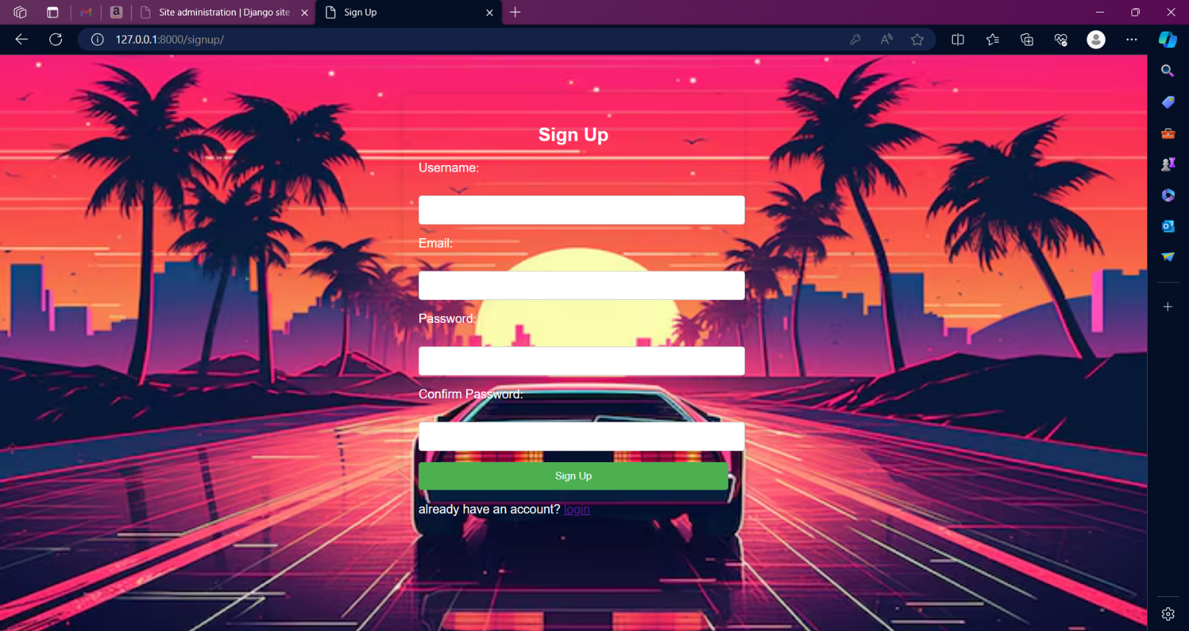
Next Gen Employability Program
Sign Up

Slide 14
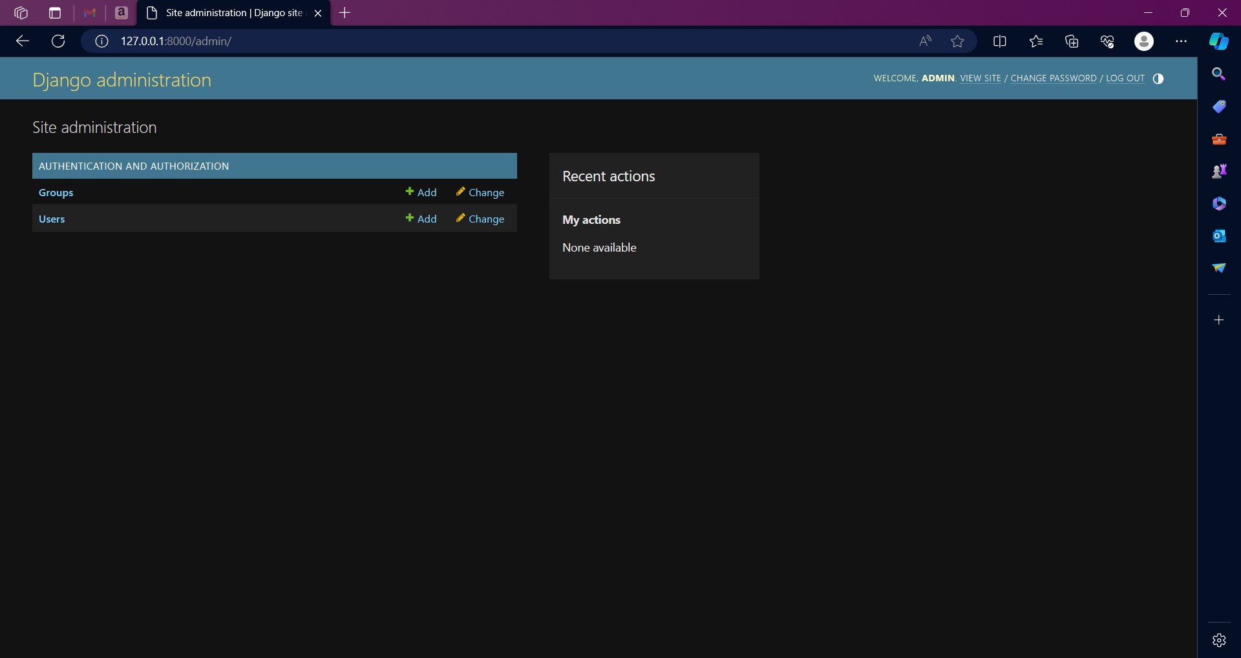
Next Gen Employability Program
Service-Page

Slide 15
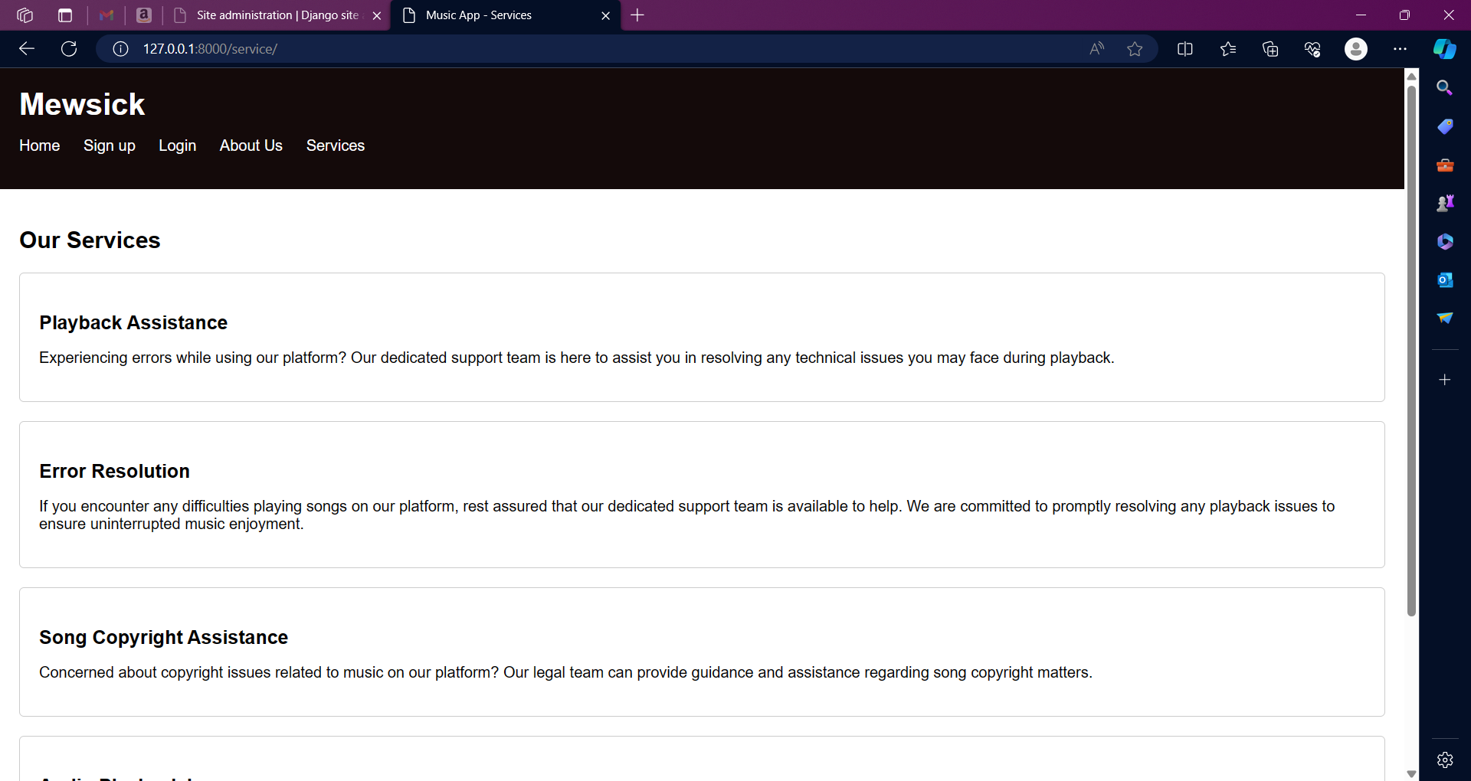
Next Gen Employability Program
About Us

Slide 16
Next Gen Employability Program
Future Enhancements:
Enhanced Recommendation Engine:
Implement machine learning algorithms to improve the accuracy and relevance of music recommendations. Incorporate collaborative filtering, content-based filtering, and hybrid recommendation approaches.
Allow users to provide feedback on recommended songs to further refine the recommendation algorithm.
Social Collaboration Features:
Expand social features to enable collaborative playlist creation among multiple users.
Introduce group listening sessions where users can listen to the same playlist simultaneously and chat in real-time.
Integration with Emerging Technologies:
Explore integration with voice assistants (e.g., Amazon Alexa, Google Assistant) to enable voice-controlled music playback and interaction.
Implement support for virtual reality (VR) and augmented reality (AR) technologies to create immersive music
experiences and virtual concert venues.
Live Streaming and Concert Integration:
Partner with artists and event organizers to provide live streaming of concerts, music festivals, and exclusive performances within the app.
Offer virtual tickets to live events and virtual meet-and-greets with artists for premium subscribers.

Slide 17
Next Gen Employability Program
Conclusion
With its innovative features, seamless user experience, and robust technology stack, Music Harmony aims to set a new standard in the music streaming industry. Whether you're a casual listener looking for your next favorite song or a dedicated music aficionado seeking deeper insights into your favorite artists and genres, Music Harmony is your ultimate music companion. Experience the harmony of music like never before with Music Harmony.
:

Slide 18
Thank You!
Next Gen Employability Program

